Slide 1

GC 14-30 Frac Observations
June/July 2025

Slide 2
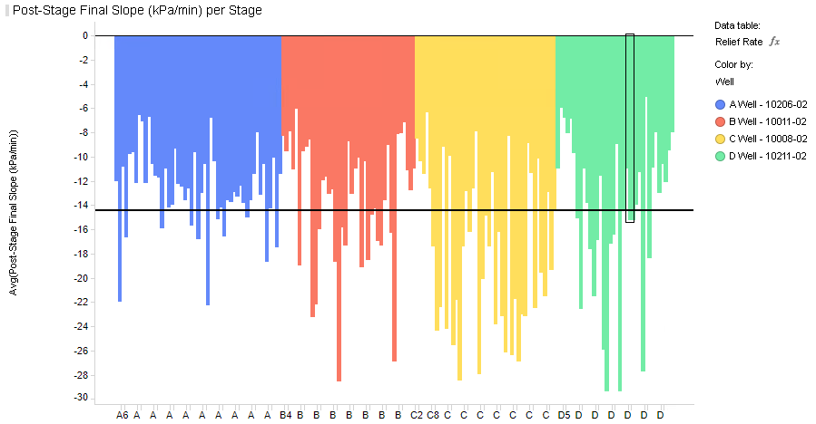
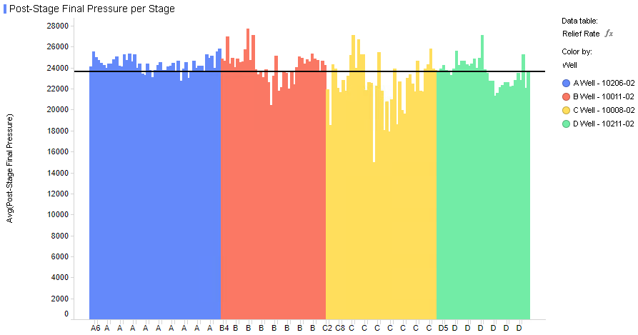
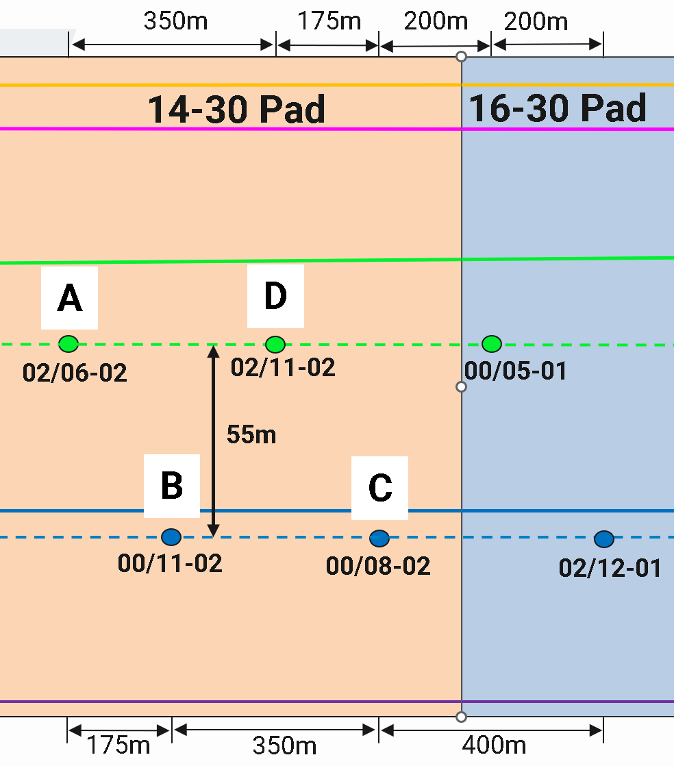
Post Stage Final Pressure Analysis – 10 Mins Before Next Stage
Conclusion: C-Well (Child well) showed strong traits of depletion – the final post-stage pressure decreasing 28% more than other MNTN A well (B-Well). C-Well also had a lower final pressure. D-Well (MNTN B) child well showed similar child traits but to a lesser magnitude.
Well | Average Final Slope (-kPa/min) | Average Final Pressure (MPa)
A-Well | 12.67 | 24.3
B-Well | 13.56 | 24.2
C-Well | 17.39 | 22.5
D-Well | 14.11 | 23.6

Slide 3
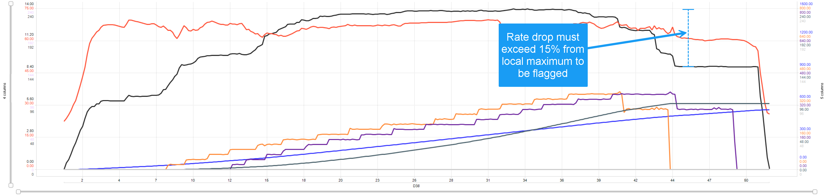
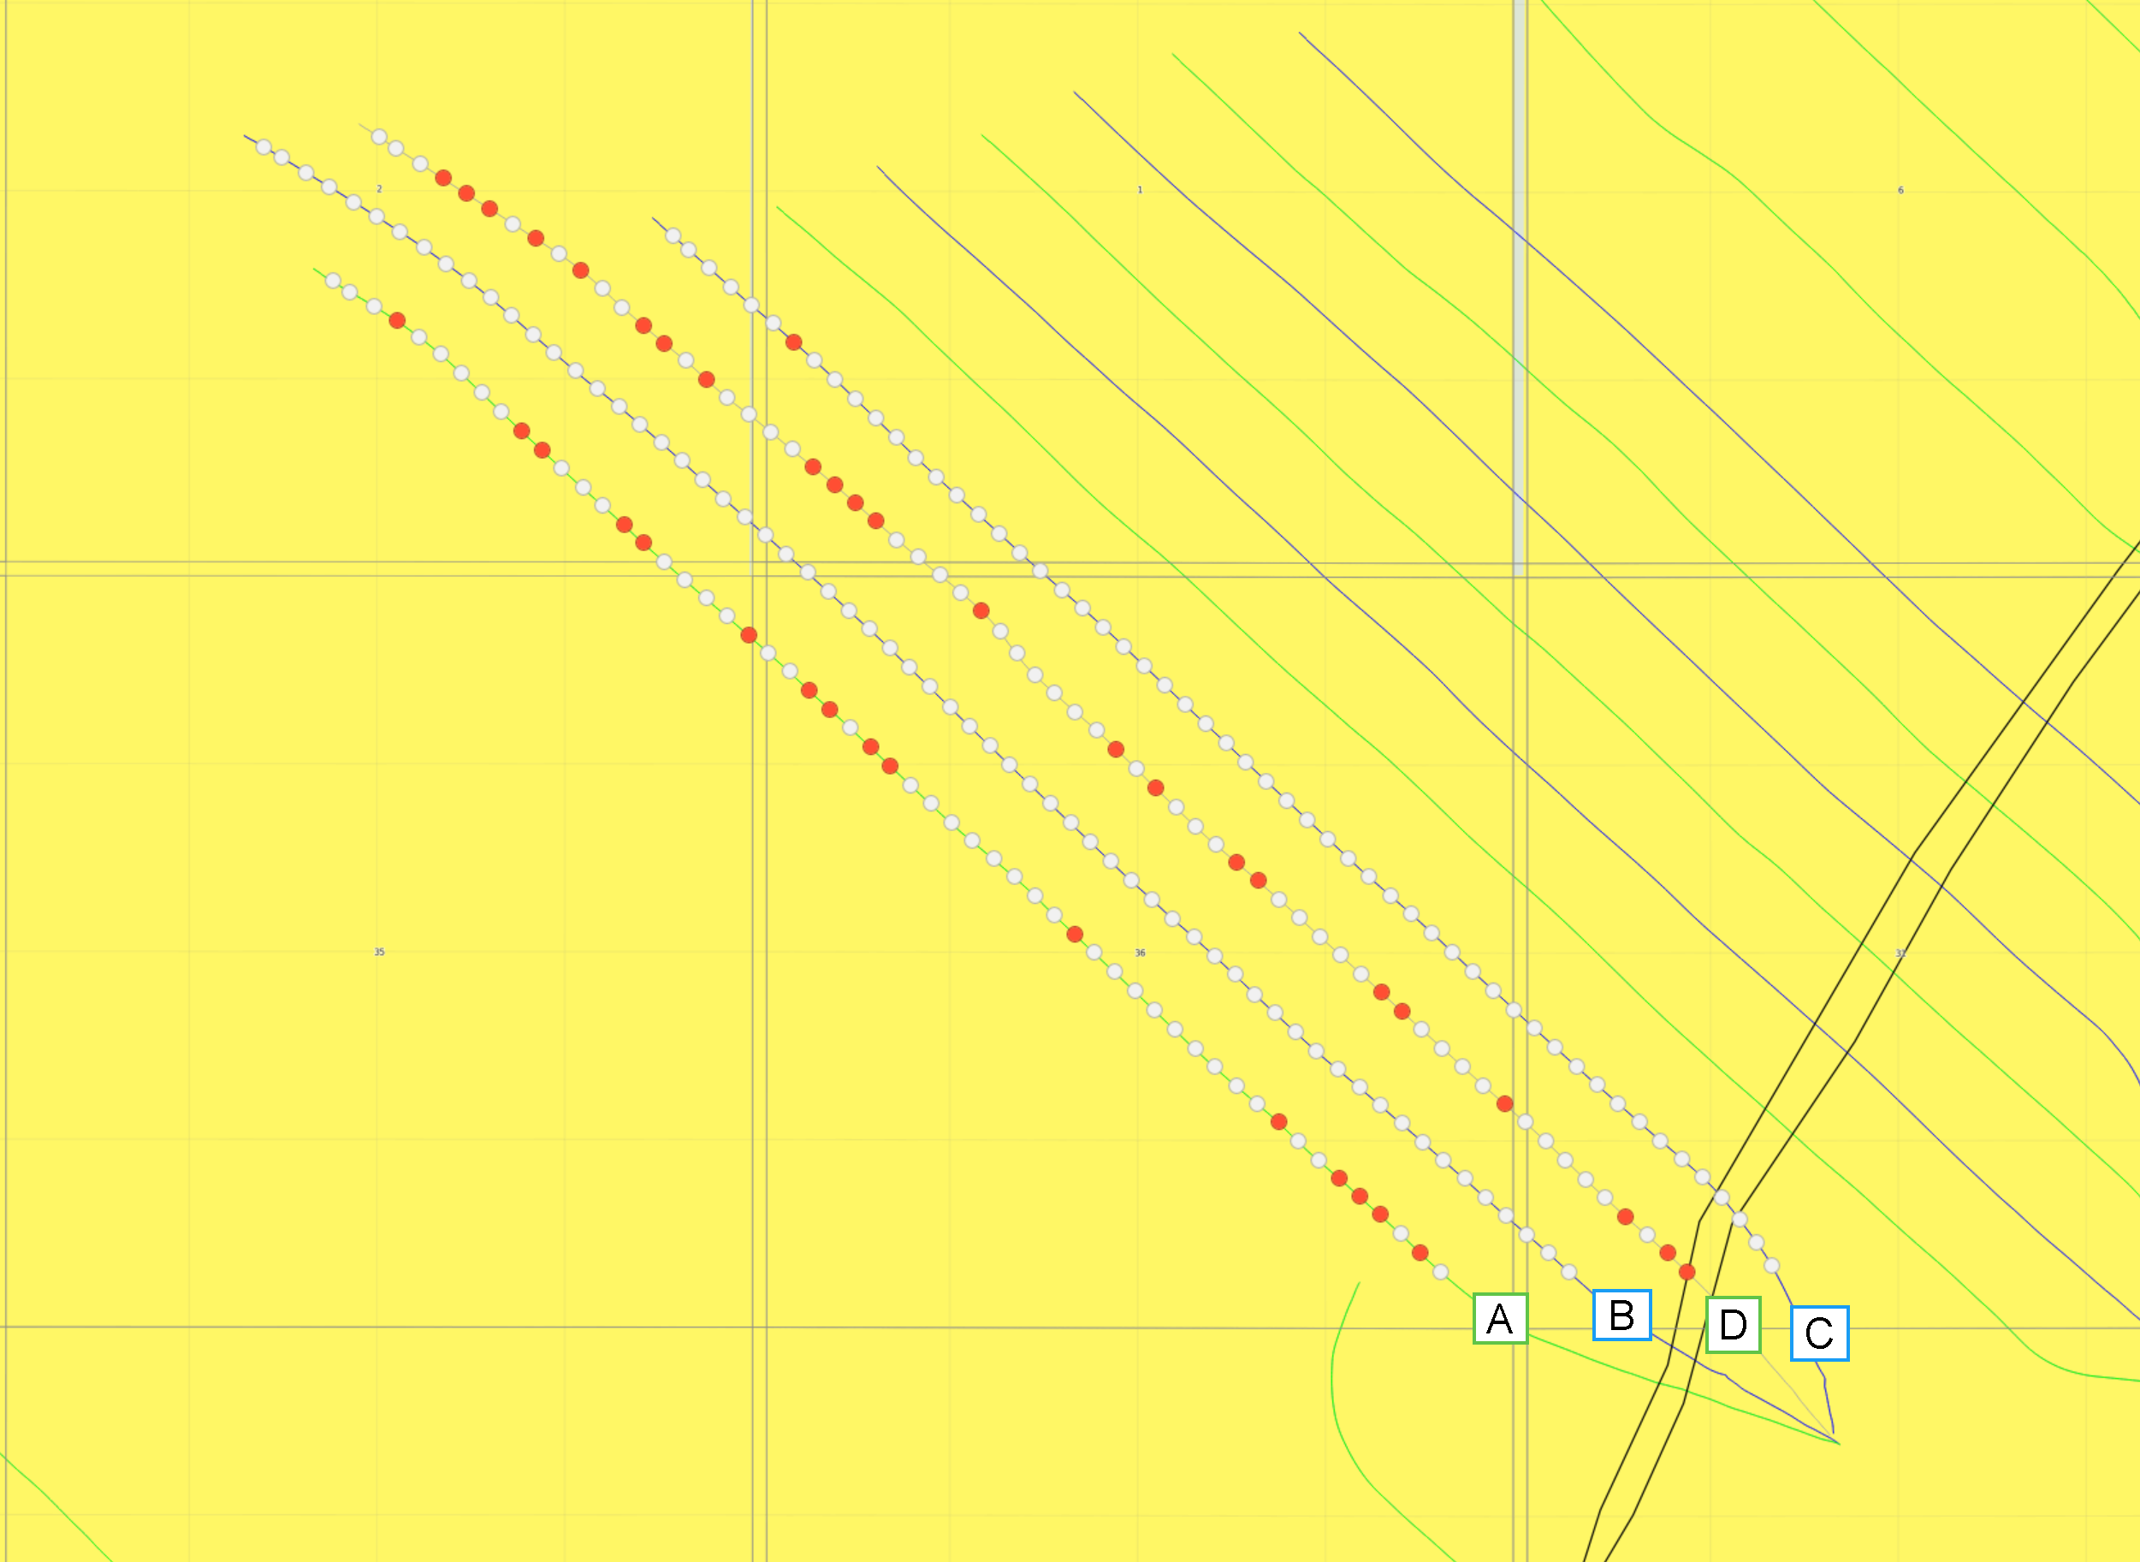
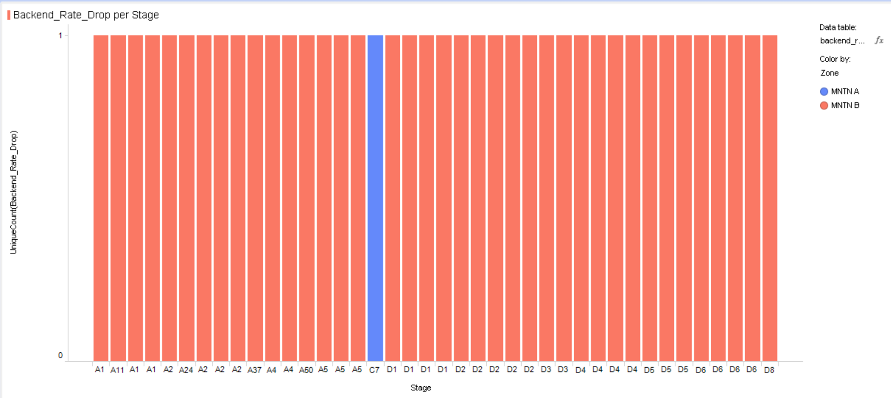
Backend Rate Drop Stages
39/40 or 97.5% of stages where backend rate drop occurred were in the MNTN B.
Conclusion: MNTN B encounters backend rate drop issues far more often than MNTN A.
Red denotes stages with backend rate drop issues

Slide 4
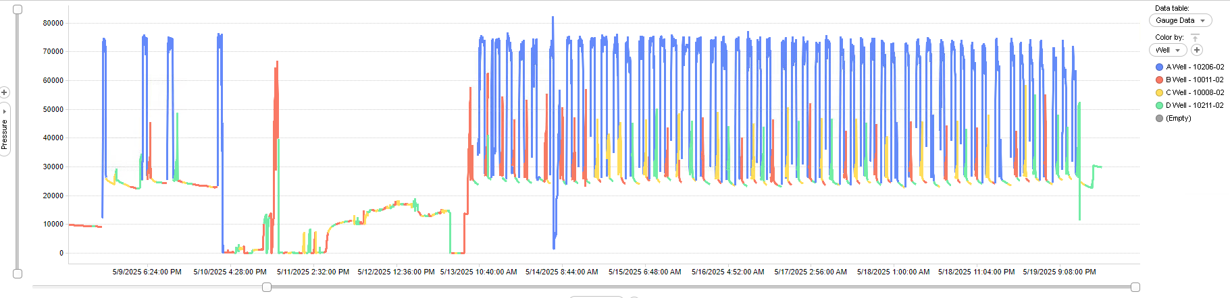
A-Well Frac Hits
No observed frac hits. For all wells it was harder to observe hits since frac was in a 3-well rotation due to early screen out on A-well, this fast rotation leaves less time to observe and noisier gauge data.
Conclusion: No frac hits. Since A-Well was lagging far behind in sequencing, no ability for other wells to communicate since as it was spatially far behind on azimuth.

Slide 5
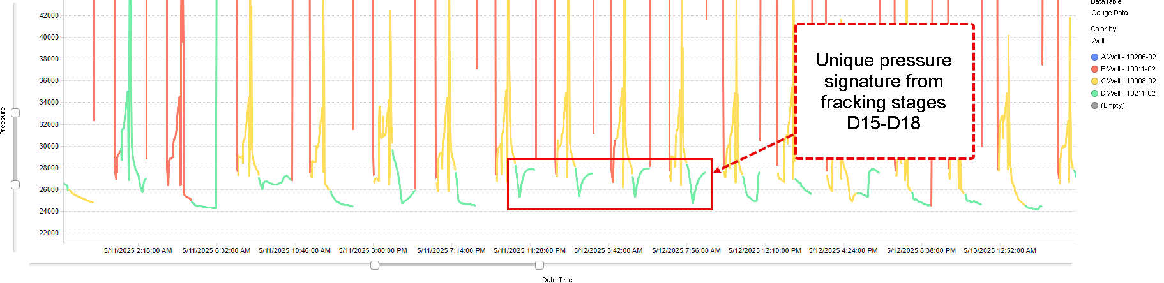
B-Well Frac Hits
Never hit by C-well. Very minor communication with A-Well at beginning (a few slope changes and <200kPa hits). Communicated relatively strongly with D-Well.
Fracking Well | Stage | Pressure Δ (kPa)
D-Well | D15 | 2600
A-Well | A11 | 300
D-Well | D16 | 2050
D-Well | D17 | 1800
D-Well | D18 | 2500
D-Well | D21 | 2200
D-Well | D37 | 300
D-Well | D59 | 650
Conclusion: Only 8 frac hits, D-Well communicated with B-Well. A-well showed pressure communication at beginning of frac.

Slide 6
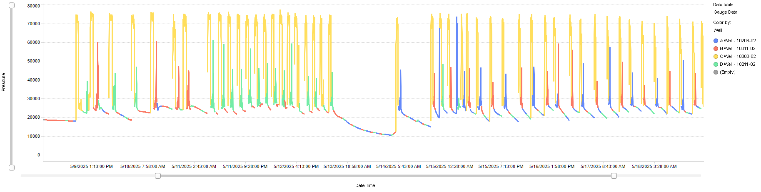
C-Well Frac Hits
Very quiet, never hit by A-Well. Communication with B-well and D-well.
Conclusion: Only two observable frac hits of similar magnitude. One from the D-well and one from B-well.
Fracking Well | Stage | Pressure Δ (kPa)
D-Well | D33 | 640
B-Well | B22 | 700

Slide 7
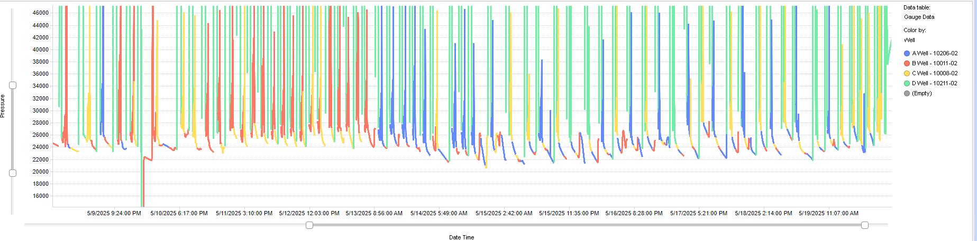
D-Well Frac Hits
Never hit by A-well. Minor communication with C-Well. Strong communication with B-Well.
Fracking Well | Stage | Pressure Δ (kPa)
B-Well | B31 | 1600
B-Well | B38 | 4300
C-Well | C26 | 2800
B-Well | B39 | 600
B-Well | B44 | 3800
B-Well | B47 | 3500
B-Well | B48 | 2000
B-Well | B56 | 1600
B-Well | B62 | 1100
Conclusion: D-Well communicated primarily with the B-Well. Had small additional communication with the
C-Well.

Slide 8
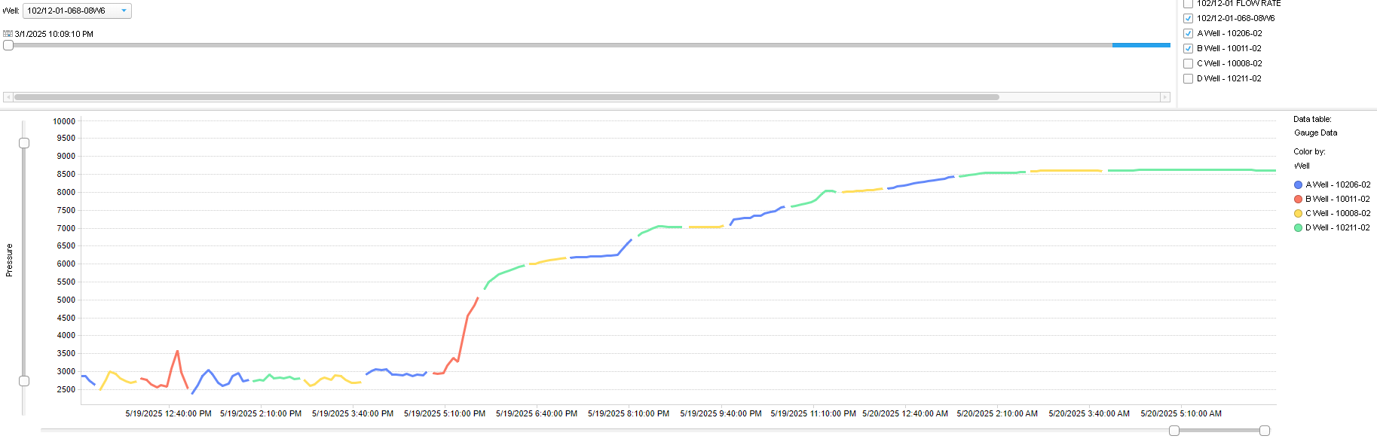
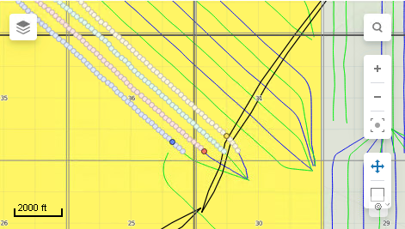
102/12-01 Frac Hits
Conclusion: Hits occurred at very end of frac (heel side only, proximal to fault). Main frac hit hypothesized to be a transient hit from C-Well. As A-well and B-well are over 750 meters away from 102/12-01. D-well can likely be ruled out on initial hit due to temporally being hours prior.
Possible initial hit stage candidates

Slide 9
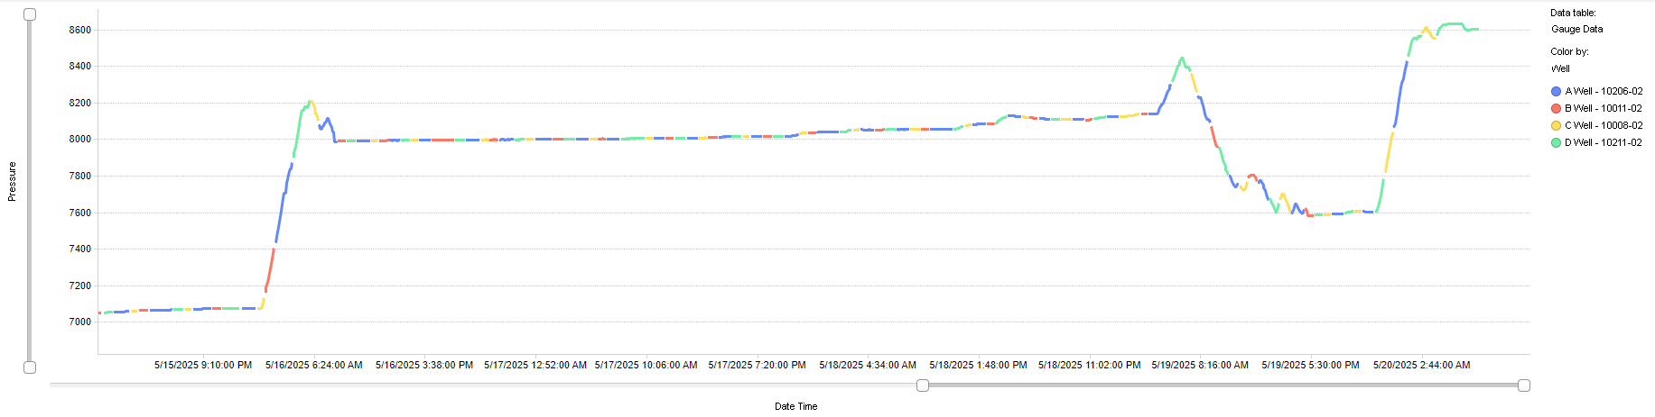
100/05-01 Frac Hits
Very quiet – note the scale of full y-axis covers a difference of 1600kPa
Conclusion: Many small (<150kPa) hits. Only three hits over 300 kPa. Hits from A, C and D-well. B-Well did not communicate.
Frackng Well | Stage | Pressure Δ (kPa)
C-Well | C32 | 1100
A-Well | A48 | 320
D-Well | D62 | 1000

Slide 10
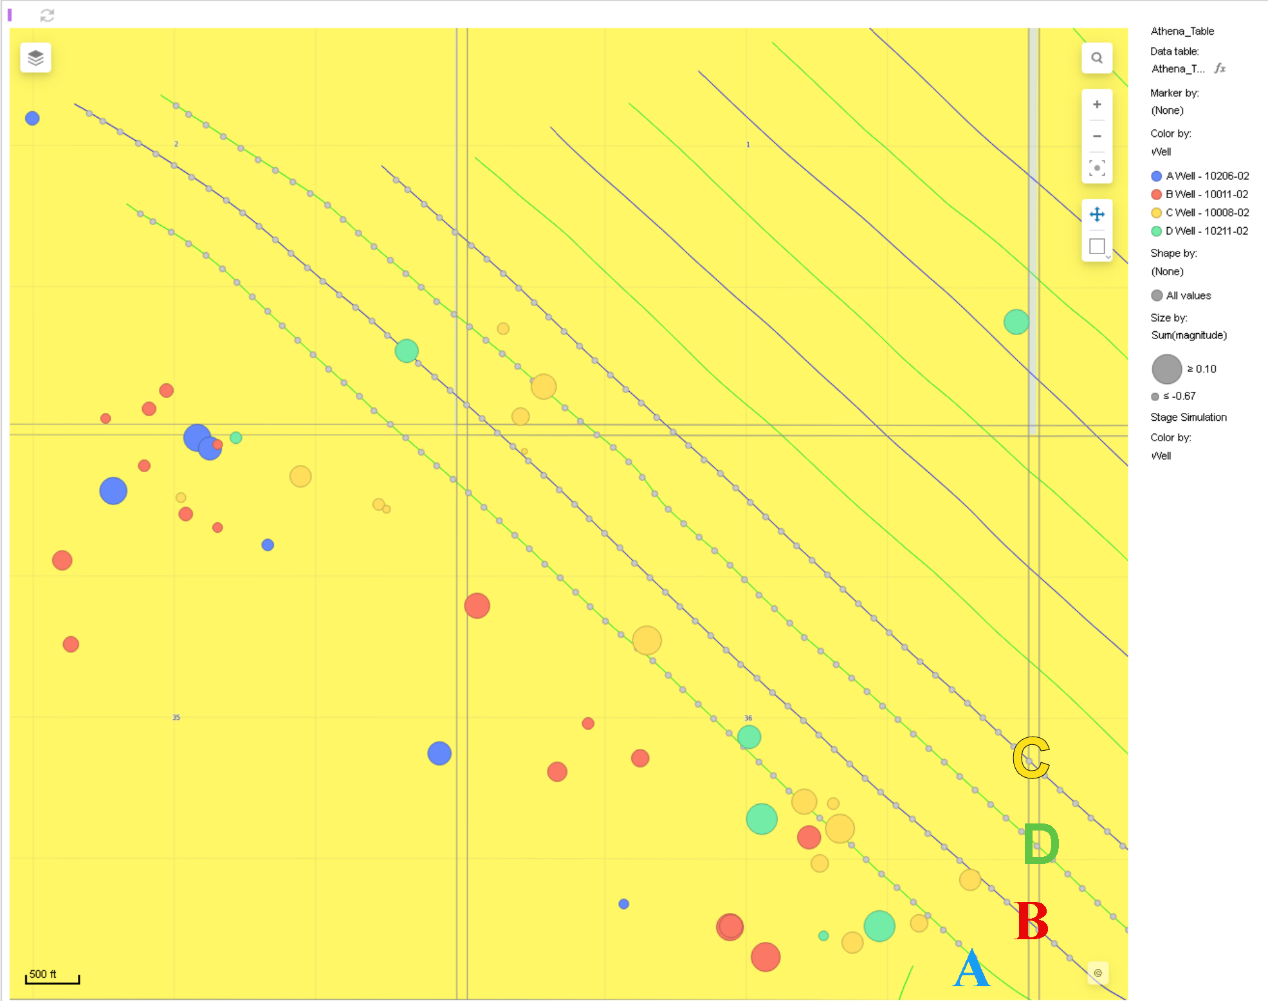
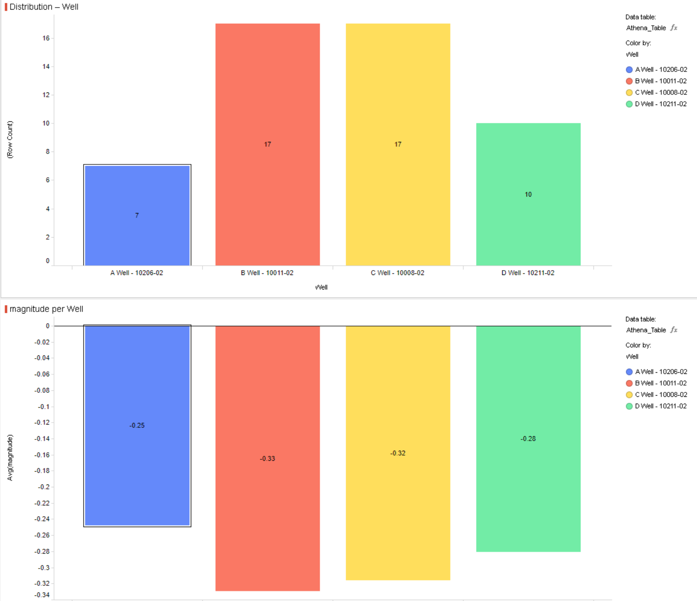
Seismic Events
No Filtering – Assignment to stage based purely temporally (what stage was being frac’d when event occurred)

Slide 11
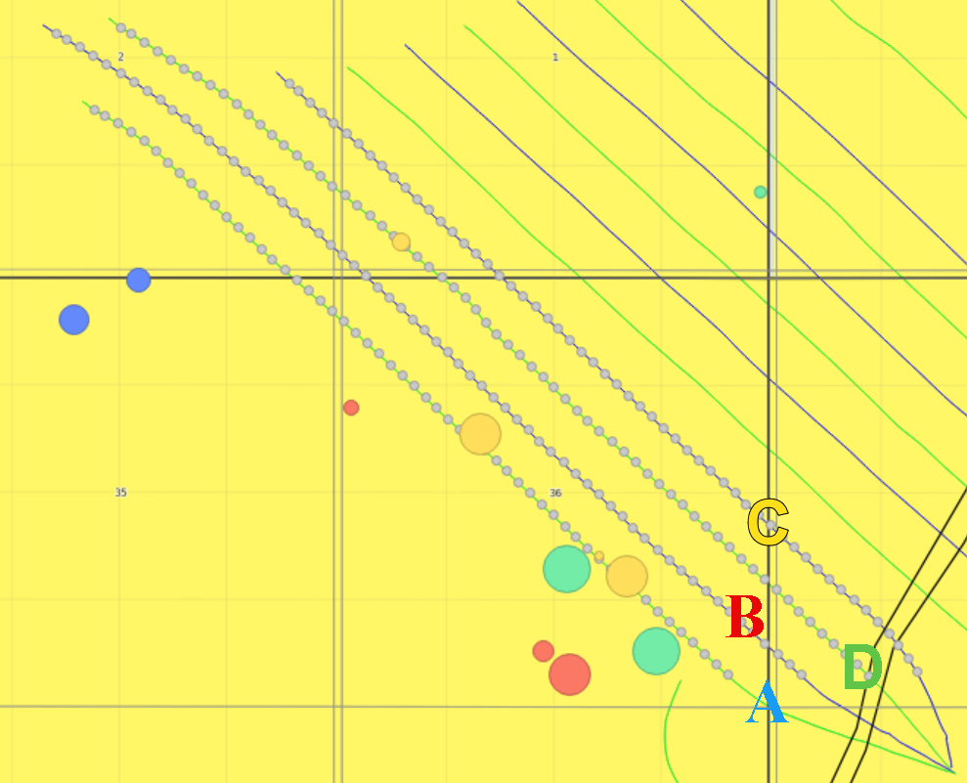
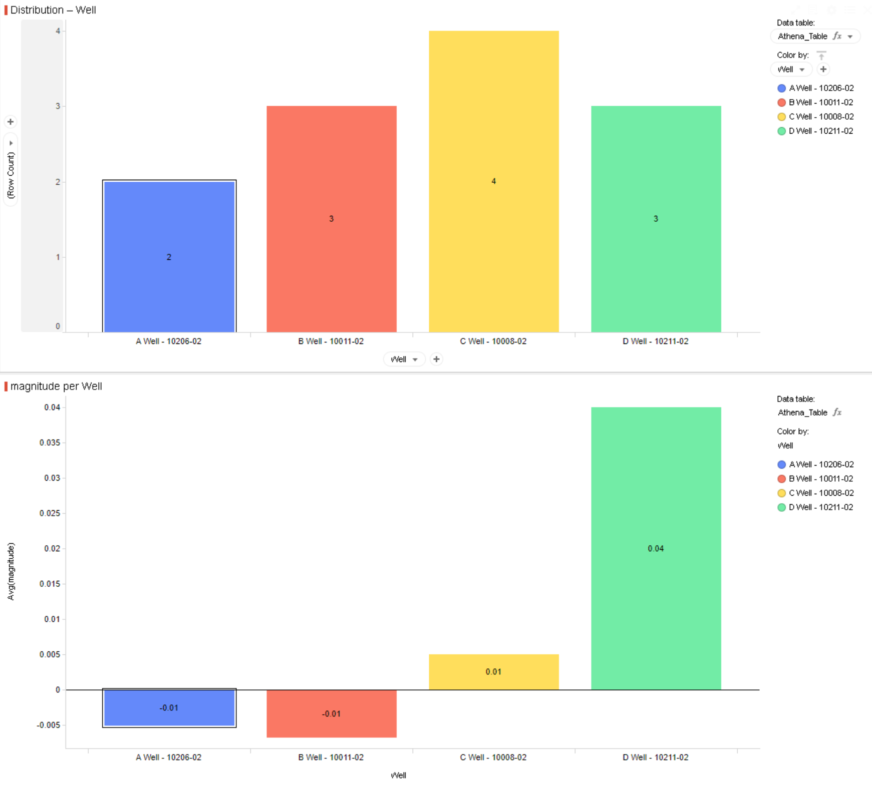
Seismic Events
Filtered to Magnitude > -0.1: Assignment to stage based purely on temporal component

